Slide 1
Fig. 1 (schematic)

Slide 2
Fig. 2 Meta-analysis?

Slide 3
Fig. 3 shared network exist between IBS, DED, and DEP
A. LD

Slide 4
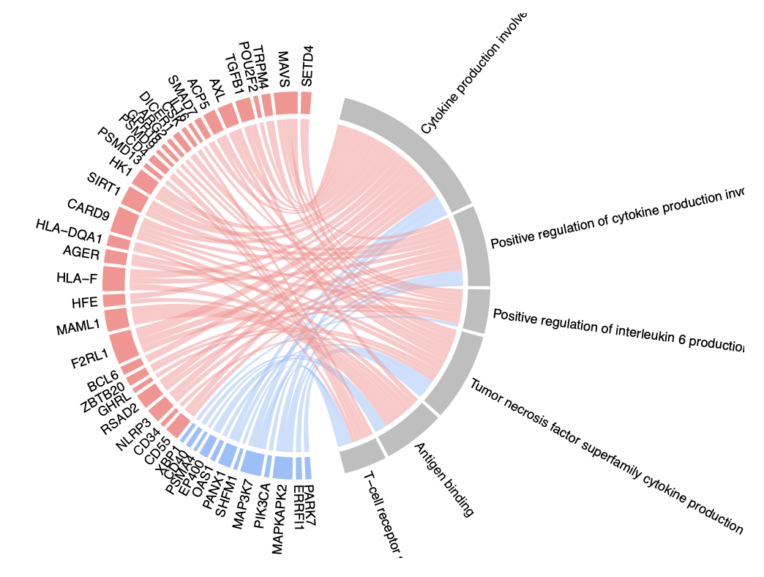
Fig. 3 shared network exist between IBS, DED, and DEP
B. Chord diagram, from MAGMA GO
DED-DEP
Notes:
MAML1

Slide 5
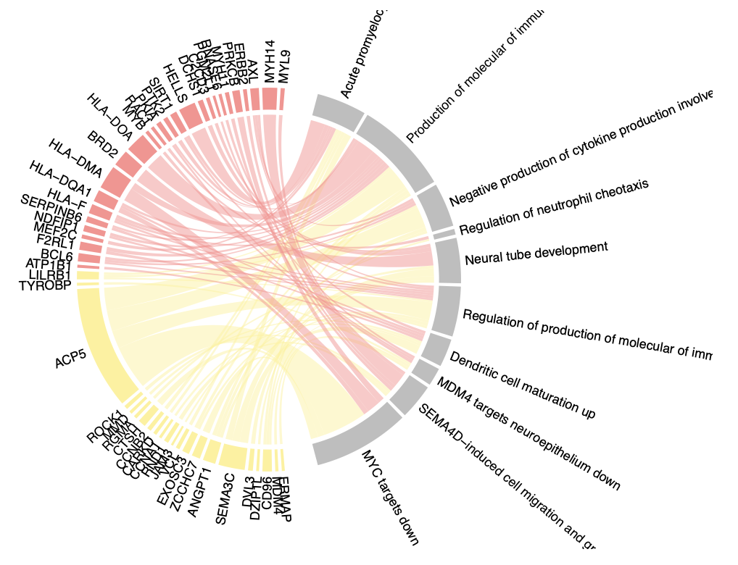
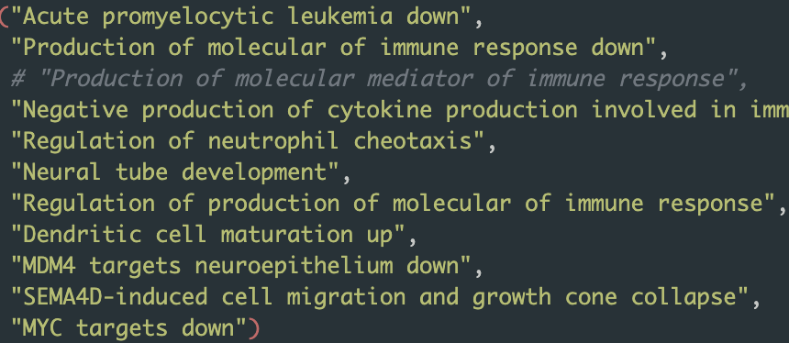
IBS-DED
Notes:
MYH14

Slide 6
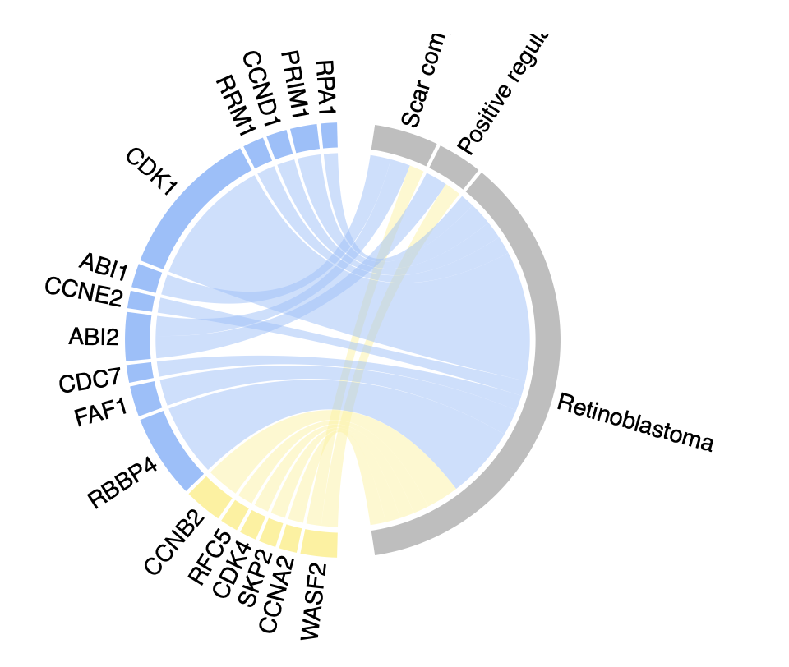
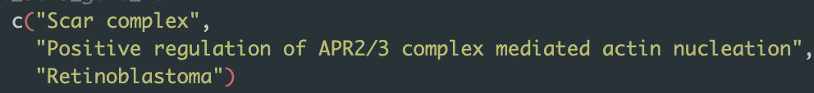
IBS-DEP
Notes:
CDK1, RBBP4

Slide 7
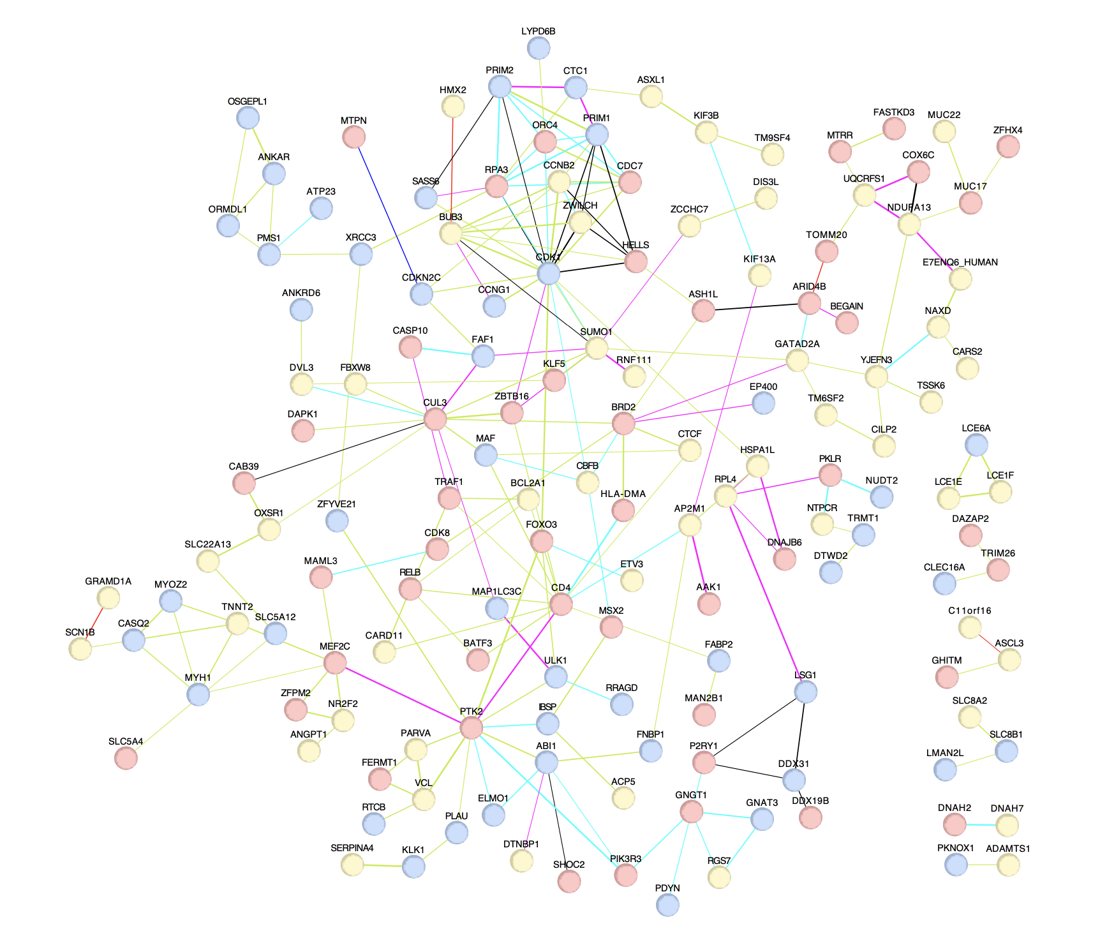
Fig. 3 shared network exist between IBS, DED, and DEP
C. PPI network, STRING
- top 100 for each / 140 nodes
- line color?
- less nodes?

Slide 8
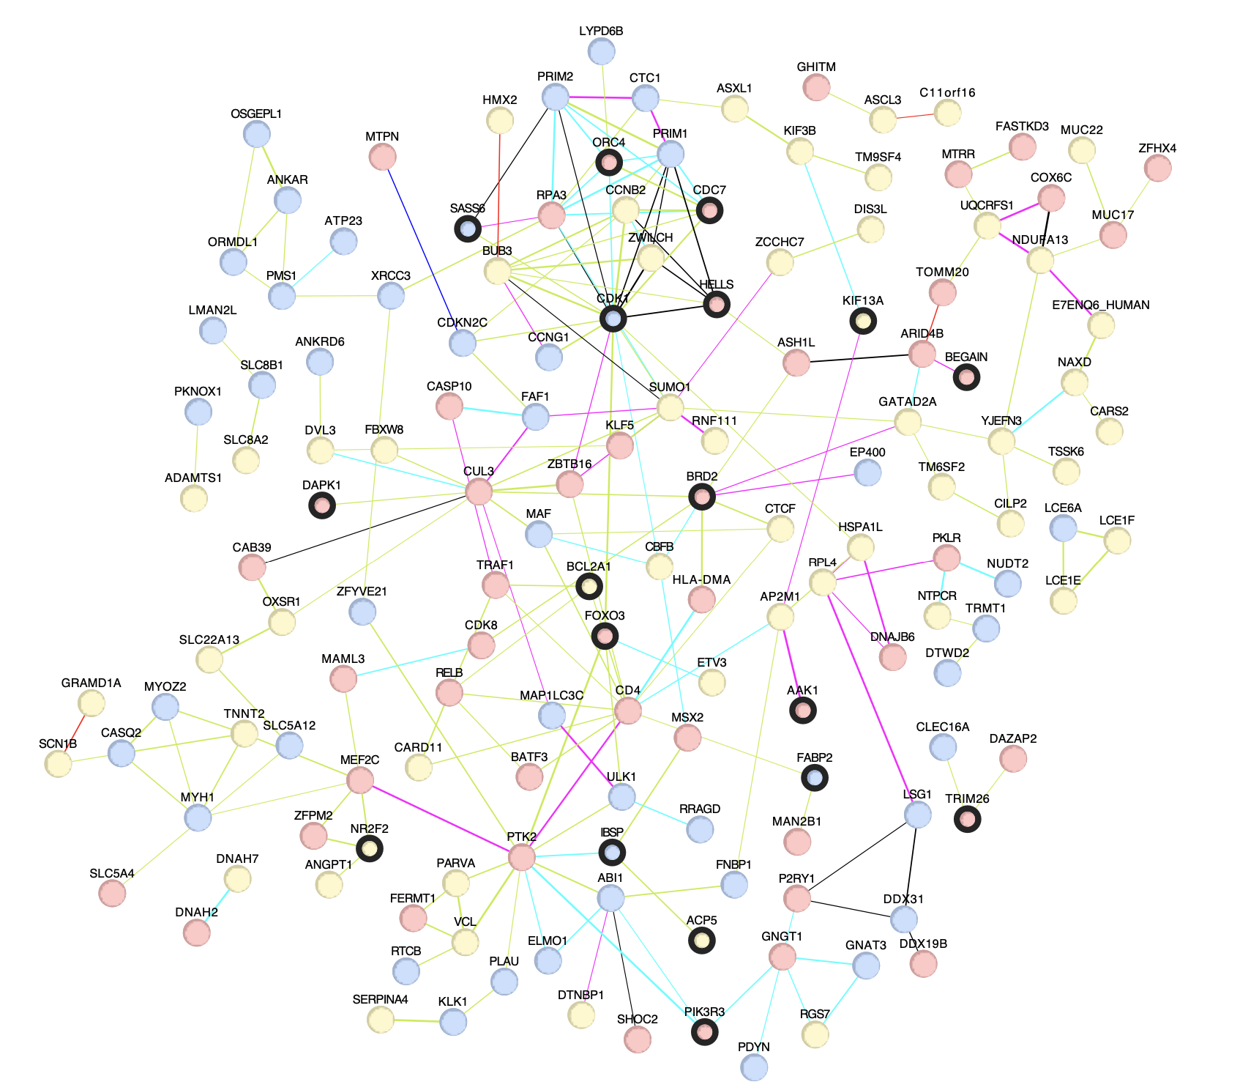

Slide 9
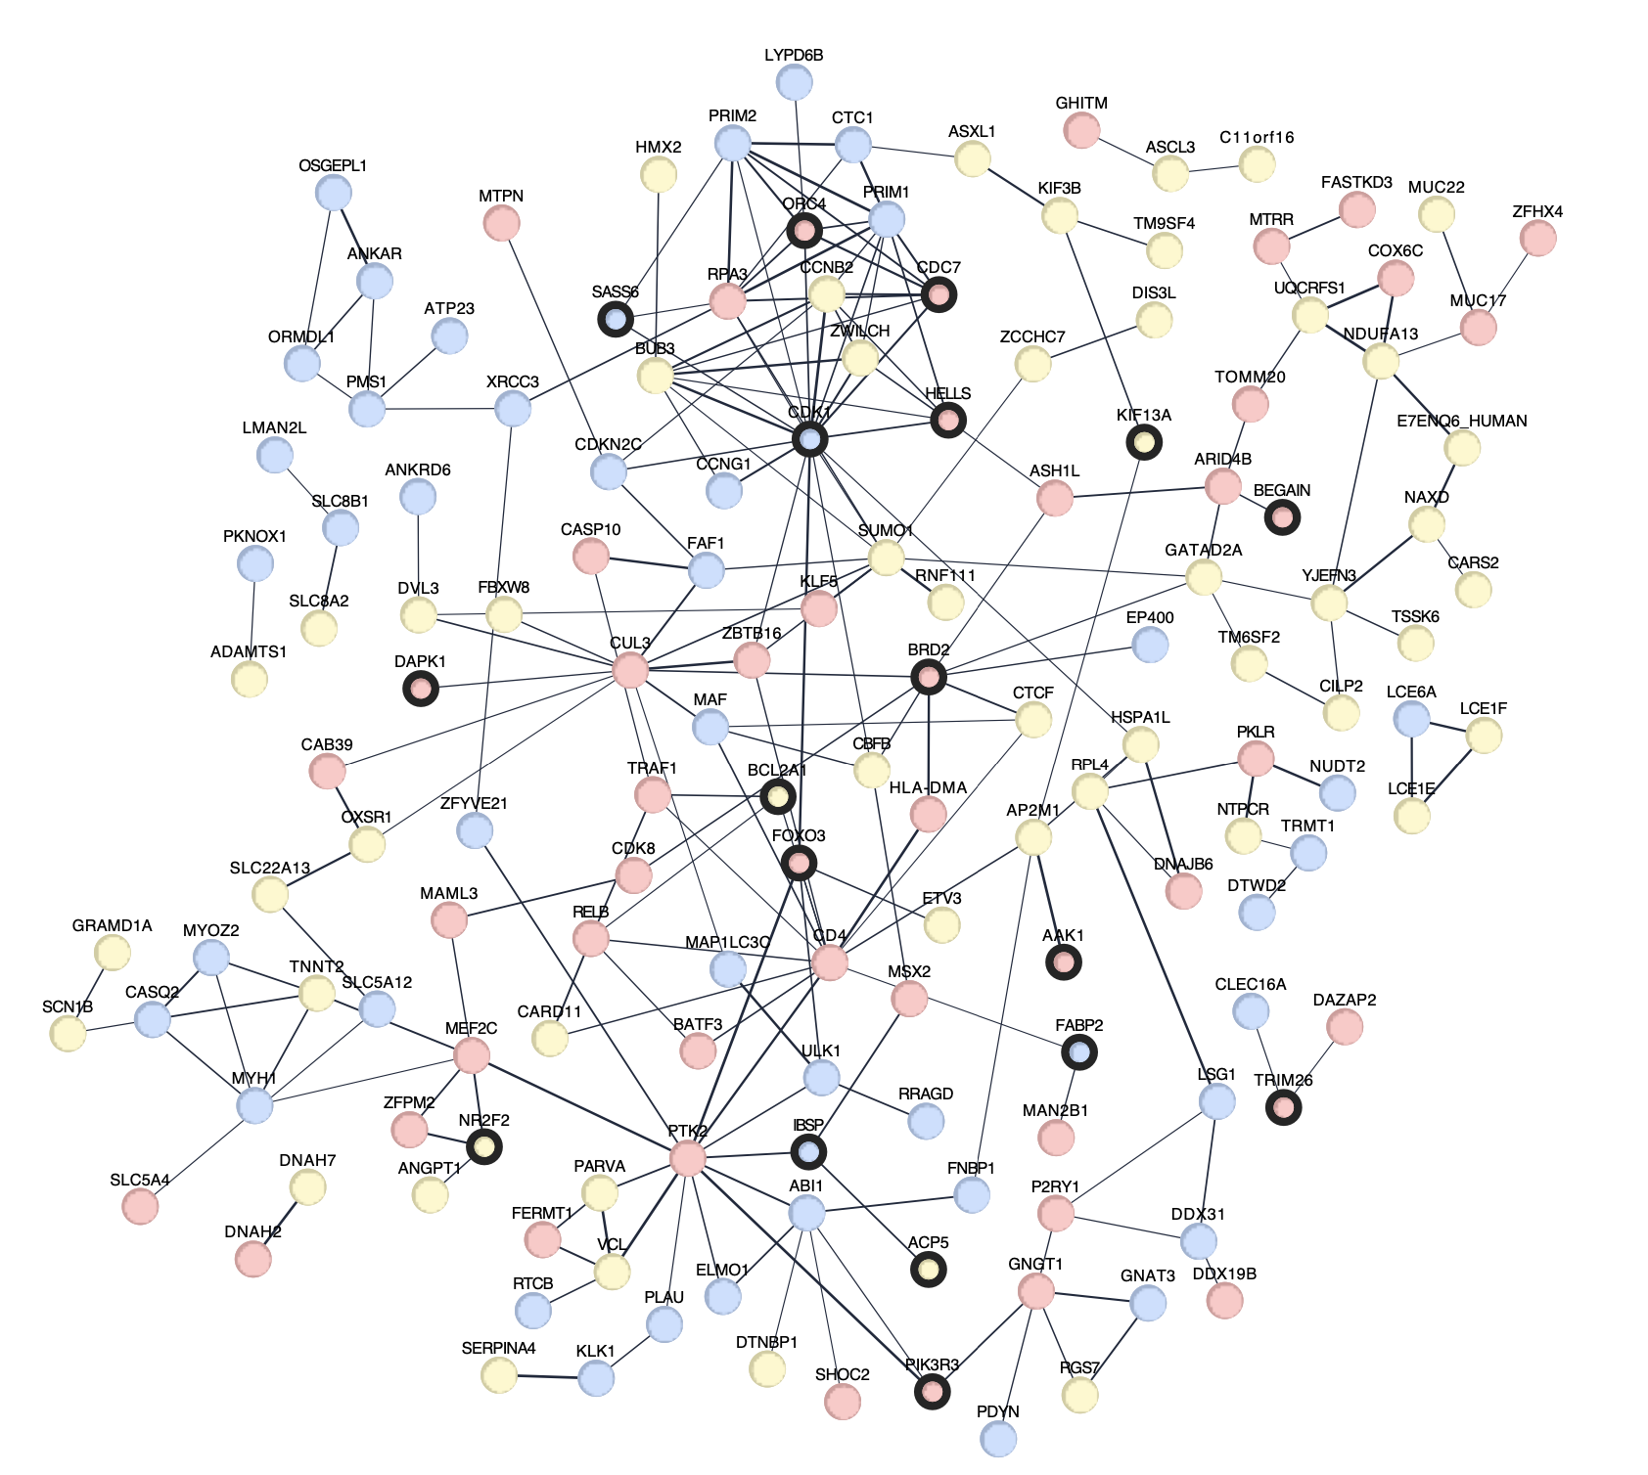

Slide 10
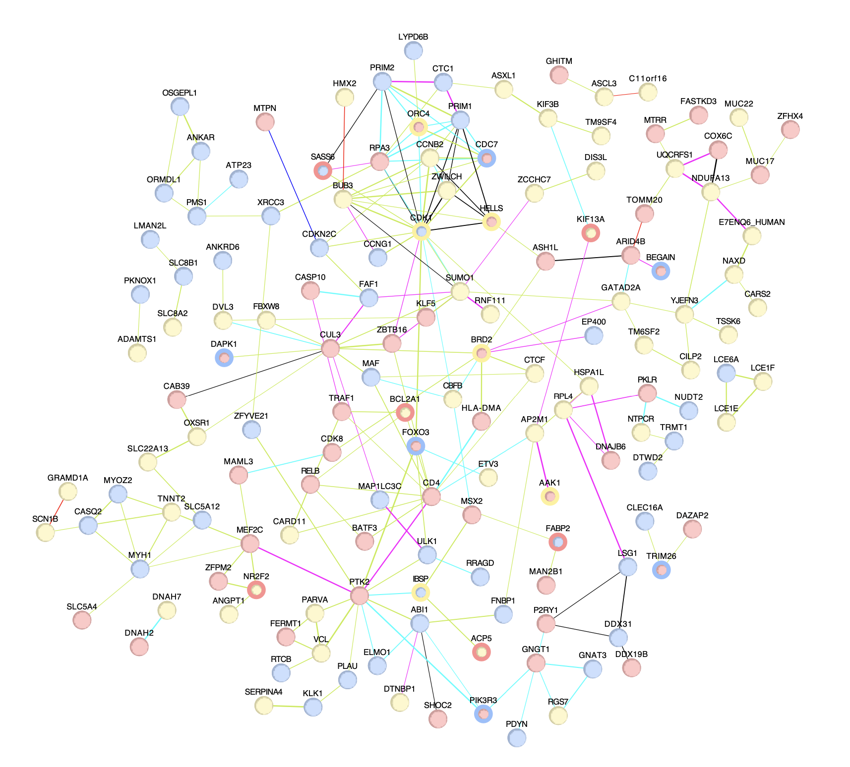

Slide 11
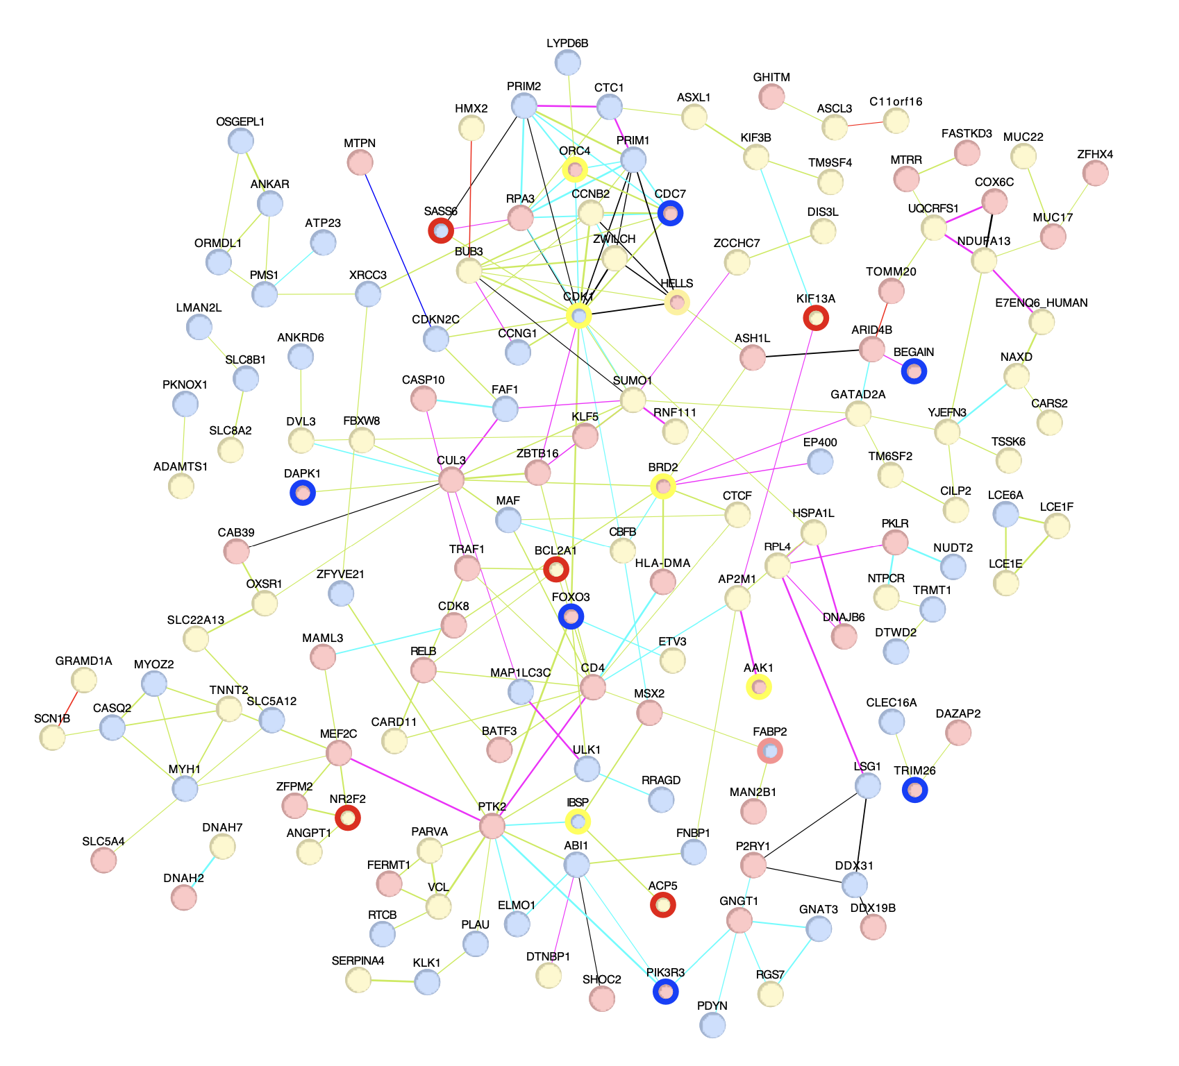

Slide 12
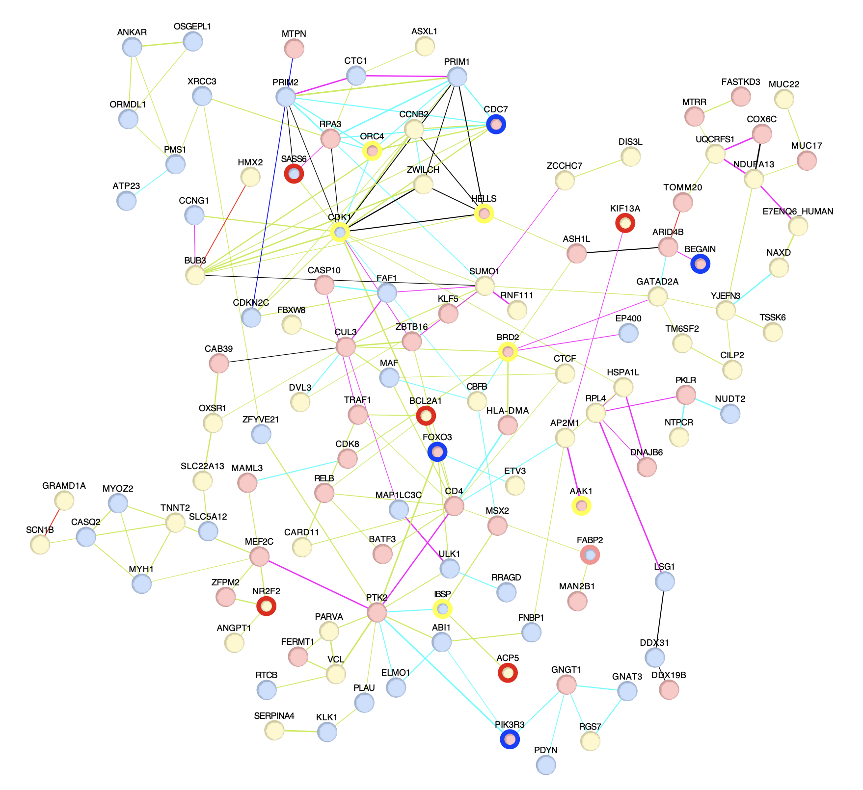

Slide 13
Fig. 4 FUMA-based
A.

Slide 14
Fig. 5 MR
A.

Slide 15
Fig. 6 localization
A.

